Slide 1



X
Designing a data warehouse and implementing stored procedures
ID/X Partners - Data Engineer
Presented by
Sayid Mufaqih

Slide 2





Sayid Mufaqih
Teacher
I’m currently a teacher but have passion in building databases and implementing ETL process through various technology.
Bangunrejo, Lampung tengah
sayidmufaqih03@gmail.com
sayidmufaqih

Slide 3
Courses and Certification
Google Data Analytics Specialization | Link January, 2024
Business Analytics with Excel: Elementary to Advanced | Link December, 2023
KPMG-AU Data Analytics Job Simulation | Link November, 2023
Programming for Everybody (Getting started with python) | Link September, 2023

Slide 4

About Company
ID/X Partners, a company that collaborates with Rakamin Academy, offers virtual internship experiences in the fields of data engineering, data science, and software engineering. Their data engineering internship program allows participants to build and manage data warehouses for e-commerce clients, thereby improving problem-solving skills and the use of SQL in data processing

Slide 5
Project Portfolio
Background :
Data :
Problem Statement :
One of the clients of ID/X Partners company which operates in the banking industry, has a need to create a Data Warehouse from several different data sources stored in their system.
sample.bak
Transaction_exel.xlsx
Transaction_csv.csv
Difficulty in extracting data from various sources (excel, csv, database) simultaneously so that reporting and data analysis always experience delays
Project explanation video here!

Slide 6

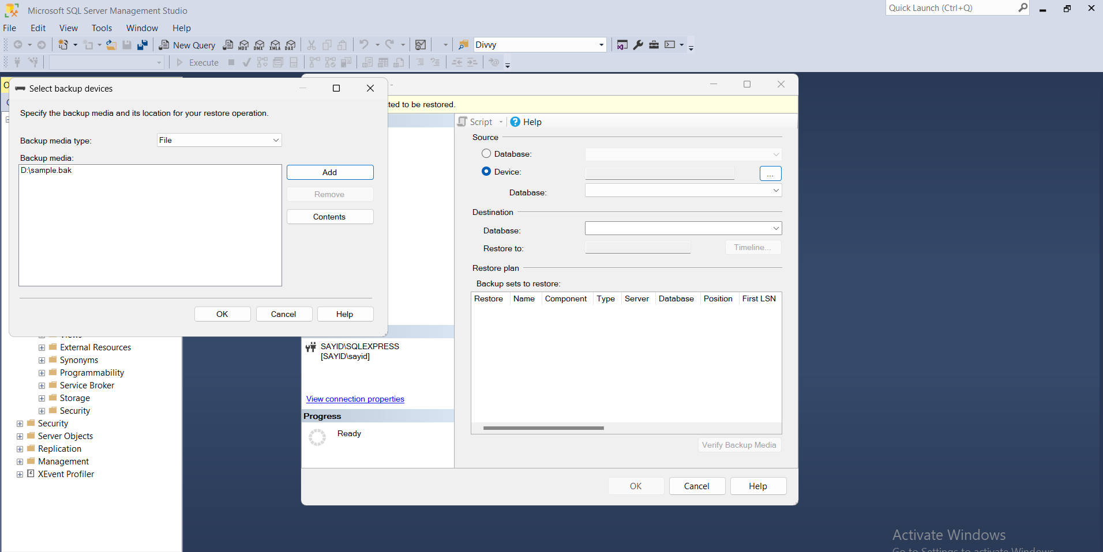
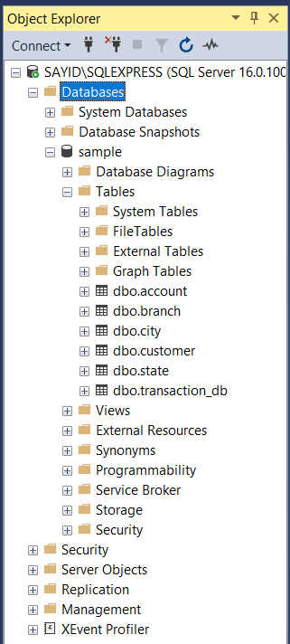
Data Warehouse Creation
1. Restore database ‘sample.bak in SSMS’
Database ‘sample’ was sucessfully restored

Slide 7
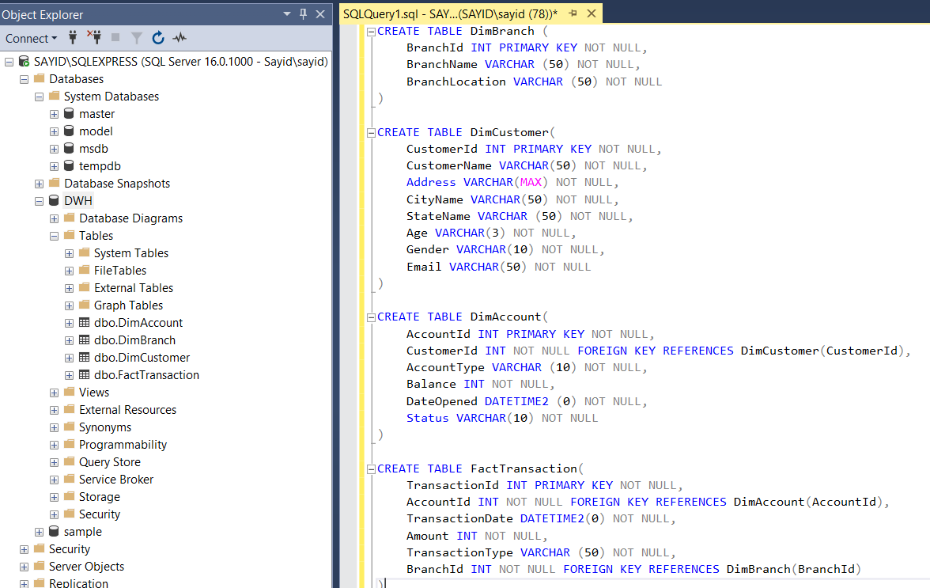
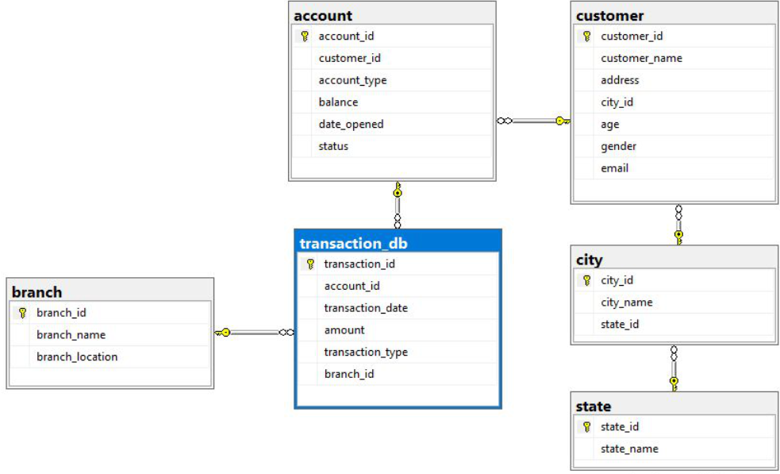
2. Create new database named DWH as Data Warehouse
Create three dimention table : DimAccount, DimCustomer, DimBranch and
one fact table: FactTransaction
Scheme in DWH Database

Slide 8
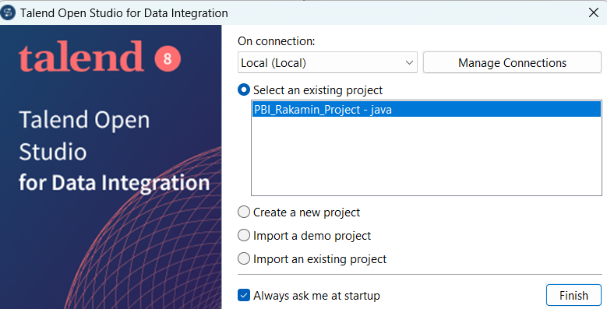
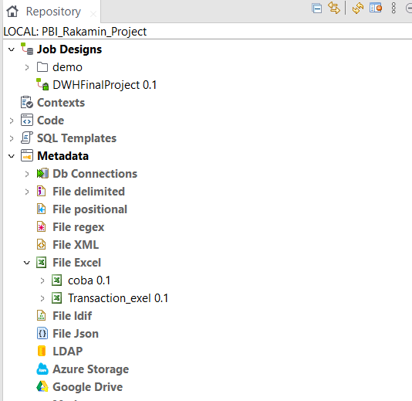
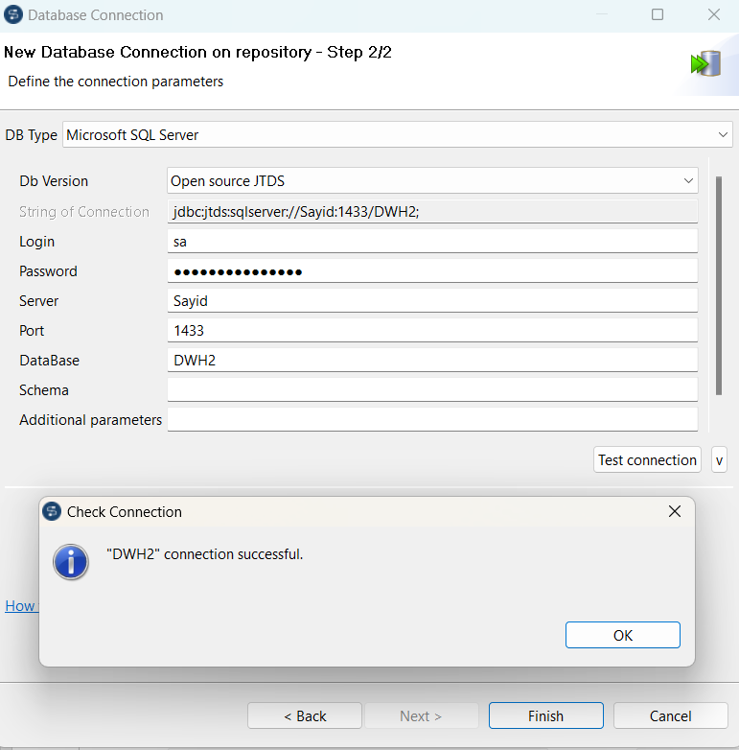
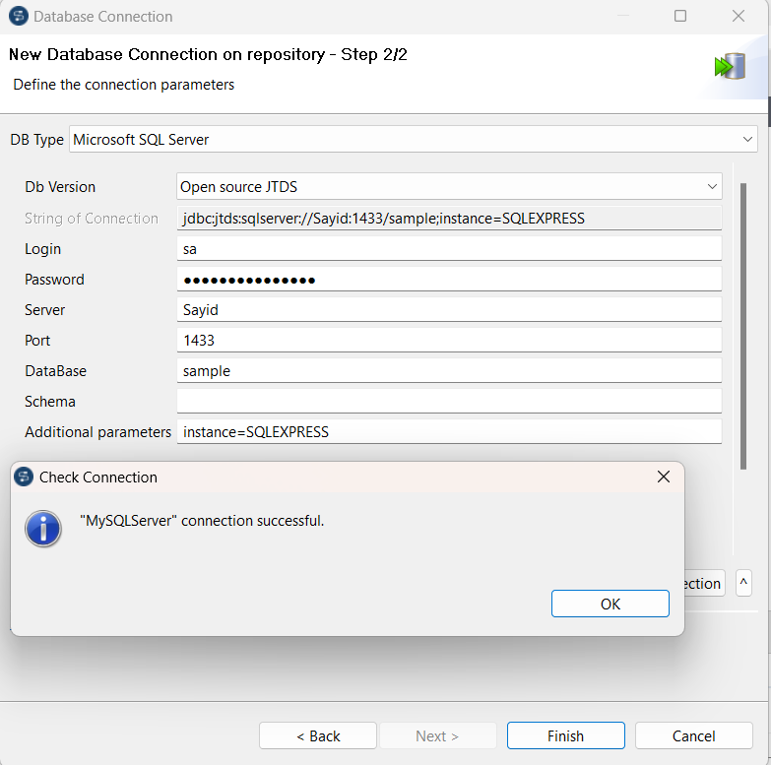
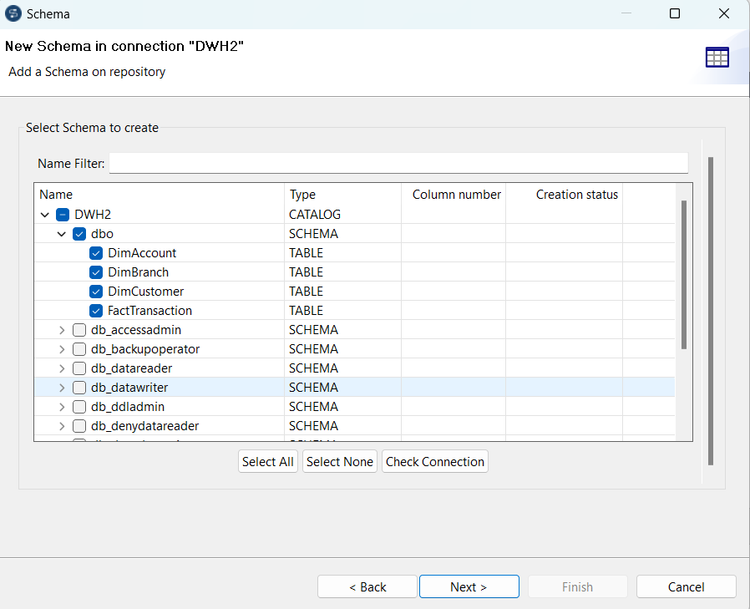
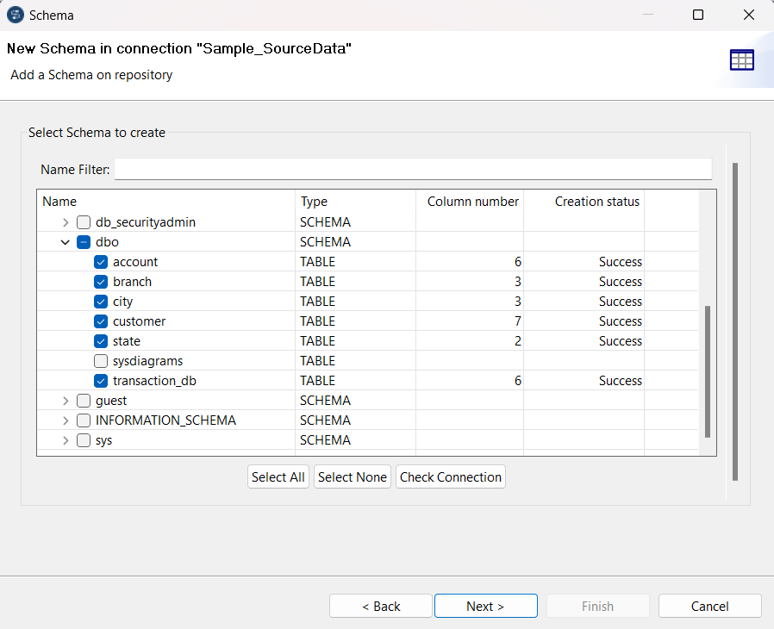
2. Connect and add data to Talend
1. Make project in Talend
2. Make connection for database sample and DWH
3. Make schema in connection and set the table name, data type, etc. as appropriate

Slide 9
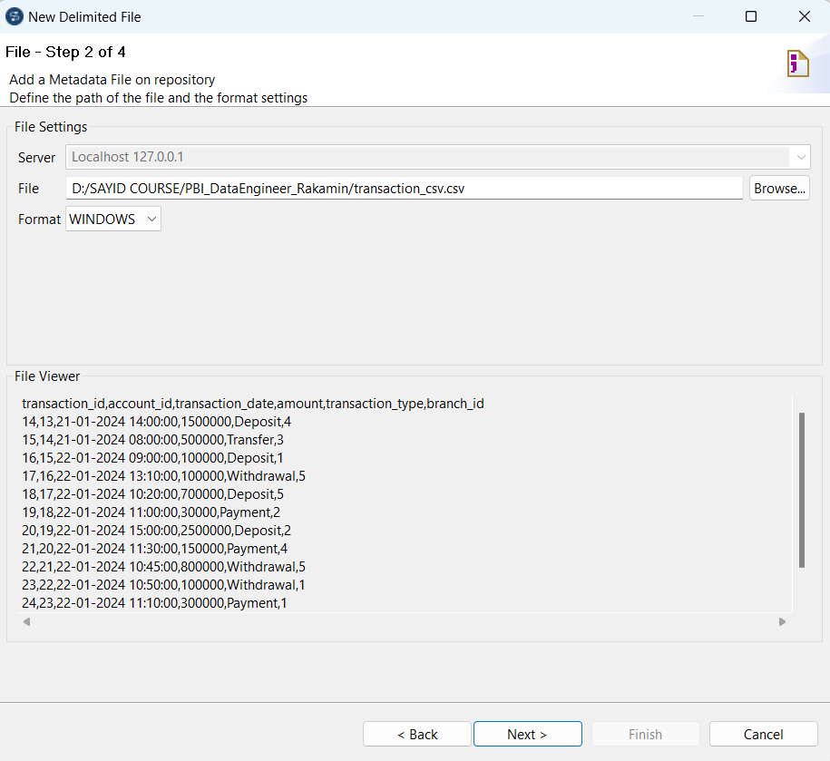
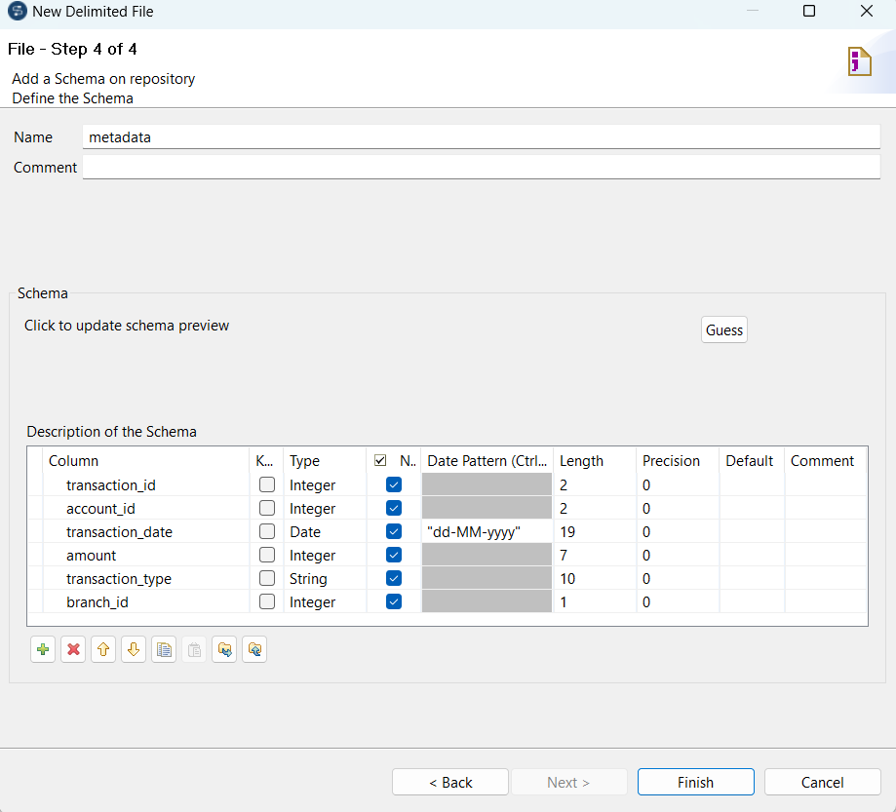
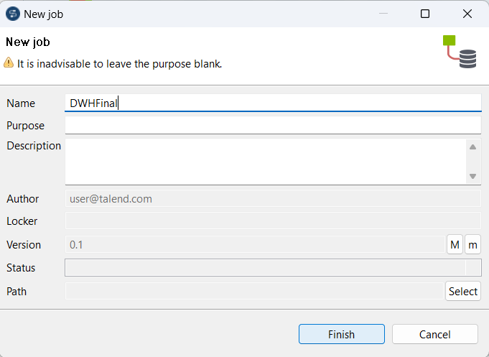
4. Add a metadata file from Excel and CSV
5. Make new job in Talend

Slide 10
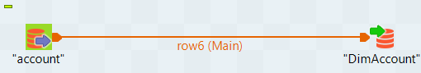
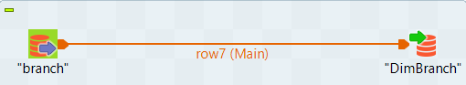
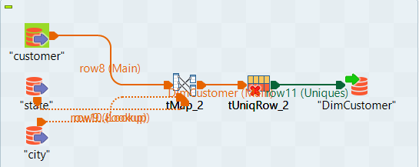
Create ETL Job for Dimension Table
Transfer data from source (account) to dimention table (DimAccount)
Transfer data from source (branch) to dimention table (DimBranch)
DimAccount and DimBranch table columns follow the columns of the existing table from the source.
Use tMap to carry out data manipulation according to needs
Transfer data from source (customer,state,city) to dimention table (DimAccount)
DimCustomer is formed from the combination of the customer, city and state tables to retrieve the CityName and StateName columns.
Use tUniqRow to retrive only unique values

Slide 11
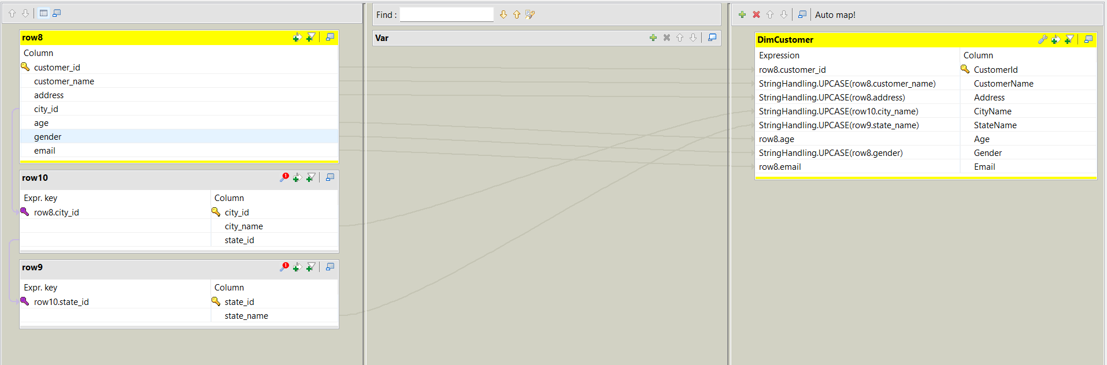
tMap used to transform data in DimCustomer
For DimCustomer tables, format the column stored is CustomerID, CustomerName,Address,CityName,StateName,Age,Gender, Email. All data from that column is changed be capitalized except for columns CustomerID, Age and Email
DimCustomer is formed from the combination of the customer, city and state tables to retrieve the CityName and StateName columns.

Slide 12
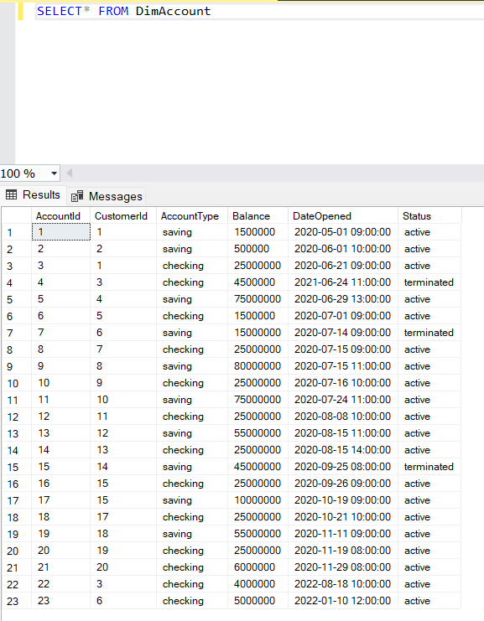
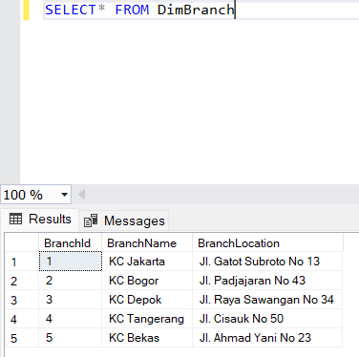
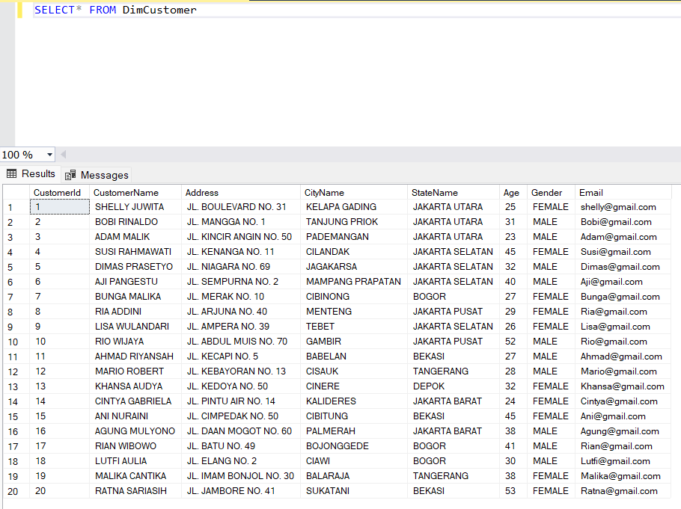
Result : DimAccount table in DWH database
Result : DimBranch table in DWH database
Result : DimCustomer table in DWH database

Slide 13
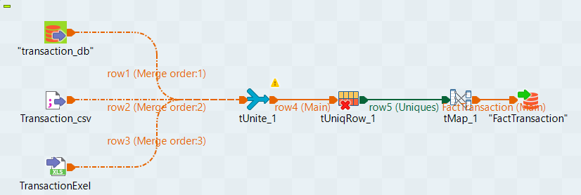
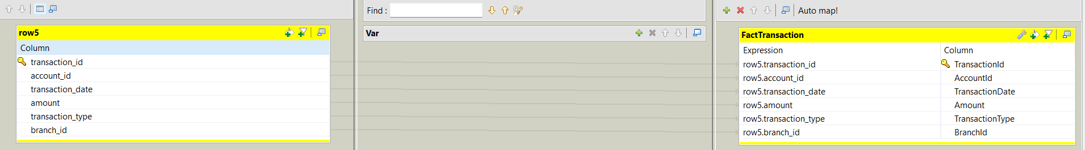
Create ETL Job for Fact Table
All Fact table columns follow the columns
of the existing table from the source.
Use tUnite to combine data from different sources
Use tUniqRow to retrive only unique values
Use tMap to mapping the data

Slide 14
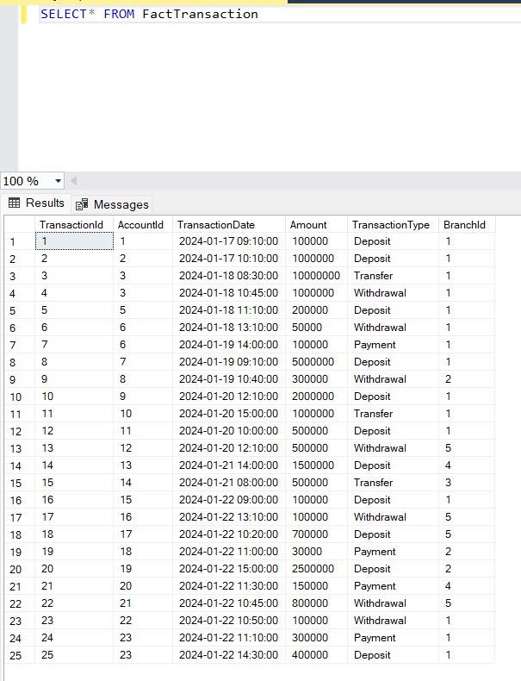
Result : FactTransaction table in DWH database

Slide 15
Create Stored Procedure
Create two Stored Procedures (SP) with parameters, to help them get a summary of the data quickly. The requested Stored Procedure is:
DailyTransaction (to calculate the number transactions along with the total nominal value every day)
BalancePerCustomer (to find out remaining balance per customer)

Slide 16
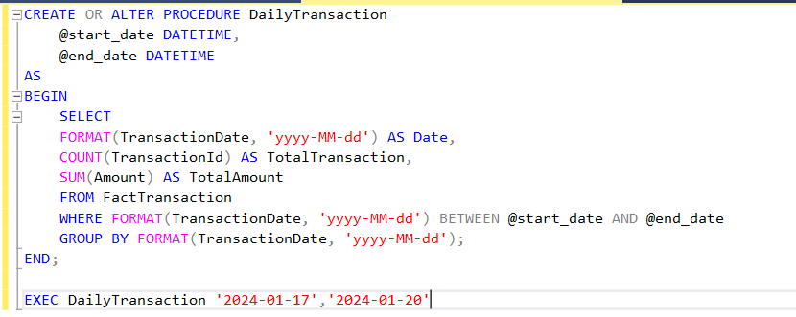
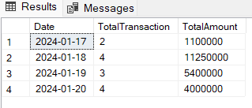
Stored Procedure : DailyTransaction
Result : DailyTransaction

Slide 17
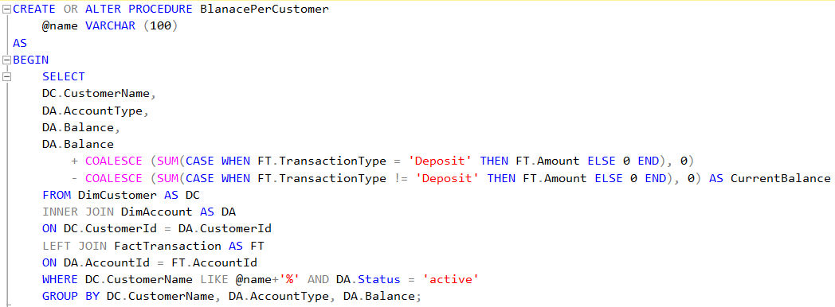
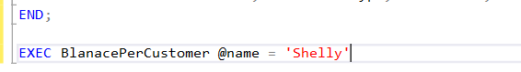
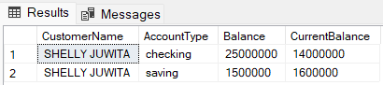
Stored Procedure : BalancePerCustomer
Result : BalancePerCustomer

Slide 18
Link Github : Hasil pengerjaan SQL
Dimention Table dan FactTransaction
Stored procedure DailyTransaction
Stored procedure BalancePerCustomer

Slide 19
Thank You
X

